Slide 1

Spatial Graphical Regression Models with application to Spatial Cancer Genomics
Liying Chen
Satwik Acharyya
Veera Baladandayuthapani
April 8, 2024

Slide 2
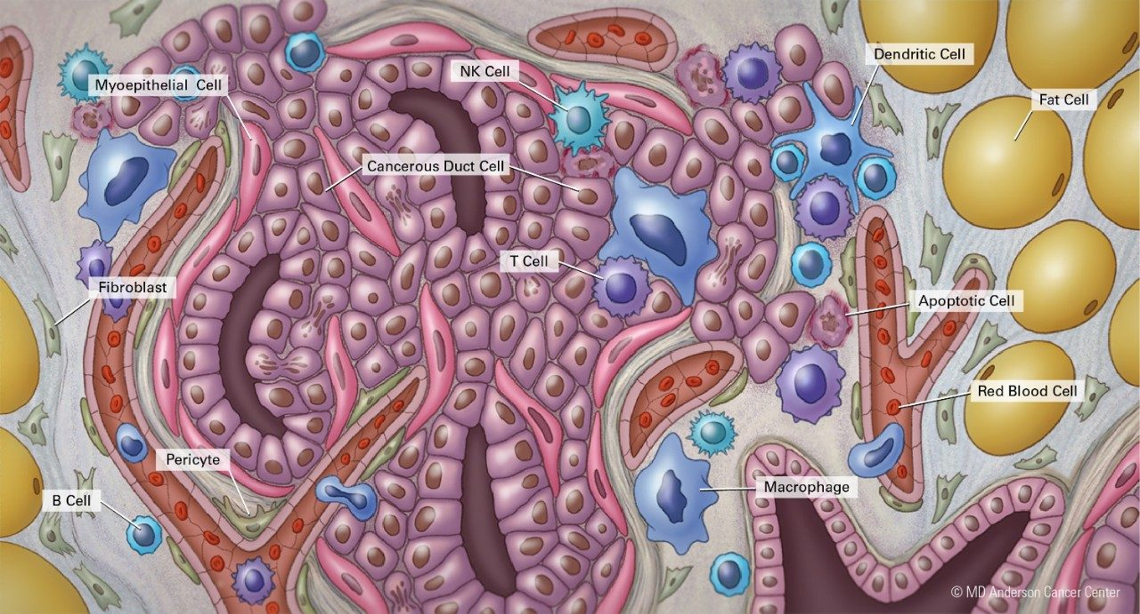
Tumor Microenvironment (TME)
Ecosystem surrounding the tumor consisting of different types of cells.
Constant interaction between tumor and its microenvironment (positive or negative).
Especially relevant for immunotherapy.
New spatial technologies such as spatial transcriptomics allow systematic assessment of TME.
Image Source: MD Anderson

Slide 3






Bulk vs. Single Cell vs Spatial
Image Source: Ospina er al., 2023
Bulk
Single Cell
Spatial
Image Source: pexels.com

Slide 4
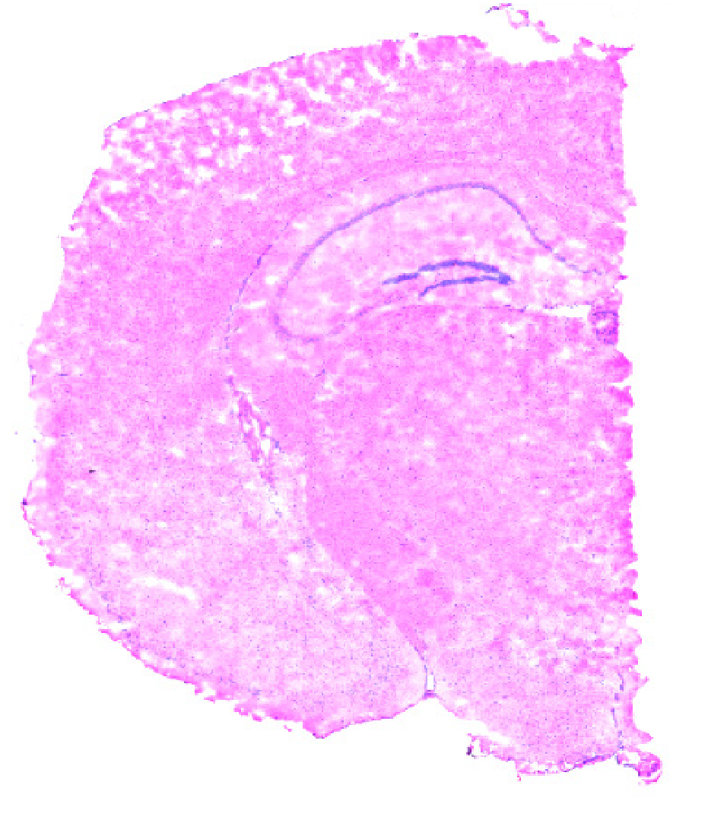
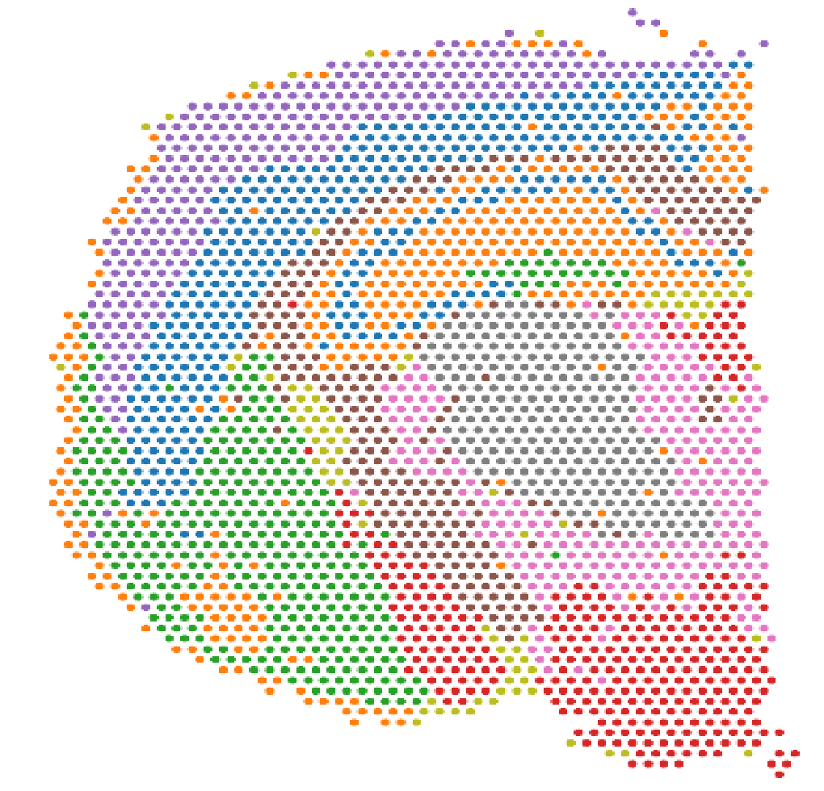
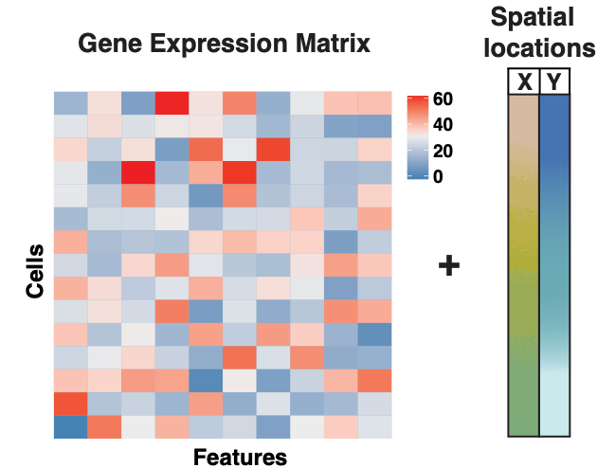
Spatial Transcriptomics
Spatial map of tissue.
Each spot is a cell or a collection of cells.
Gene expression assayed from each spot along with spatial coordinates.
Joint assessment of spatial architecture + biological processes
  e.g., tumor microenvironment in cancer.
high n (cells) and high p (genes) data.
Tissue section image
Spatial gene expression

Slide 5
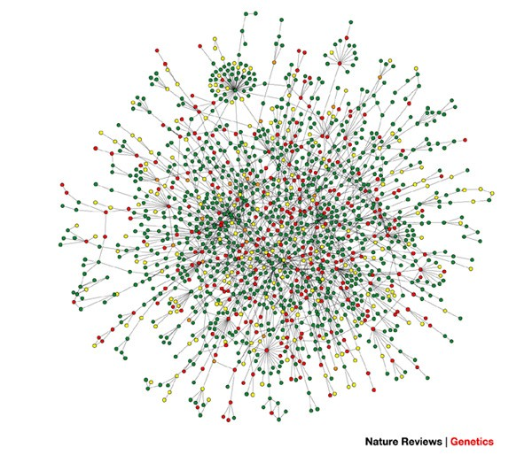
Network Biology
Basic premise: Model genomic elements (genes/proteins) and/or their products, and their association/regulatory relationships.
Higher-order organization: nodes represent genes/proteins and edges the biological function.
Better understand the complex biological processes underlying cellular/signaling systems.
  Global/systems level understanding instead of looking at local relationships (1-2 genes/proteins at a time)
  Helps us identify hub/driver components which direct biological/translational mechanisms

Slide 6
Spatially varying networks
Inferential task(s) beyond differential expression
  Co-regulation patterns that vary spatially.
  Assess gene-gene networks that vary spatially.
Many graphical/network methods for bulk and single-cell data
  Most assume homogeneity among samples (cells/spots in this case).
  Relatively few accounting for spatial dependency.
Complexity: (spatial) heterogeneity
  Non i.i.d. samples (cells or spots).
Non i.i.d. data structure

Slide 7

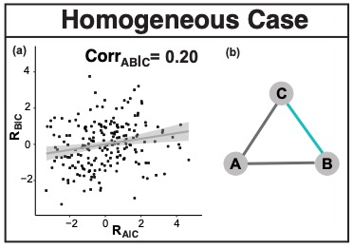
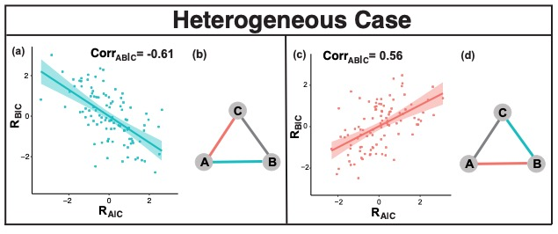
Simpson’s Paradox in Graphical Models
This becomes more complicated in the context of spatial heterogeneity

Slide 8


Today’s Lecture
Spatial Graphical models accounting for spatial dependency for single sample.
  Conditional dependency (precision matrices).
  Spatial graphical regression (SGR) with non-linear spatial dependency.
Hierarchical Spatial Graphical models for multiple spatial surfaces.
  Borrowing strength across spatially varying precision matrices.
  Hierarchical Spatial graphical regression with global-local spatial dependency.
$$Y|S\sim N\left(0,Ω^{−1}\left(S\right)\right)$$
$$Y_{k}|S\sim N\left(0,Ω_{k}^{−1}\left(S\right)\right)$$

Slide 9
Spatial Graphical Regression

Slide 10


Gaussian Graphical Model
Notations
  $Y∈ℝ^{n∗p}$: features matrix$; i=1,…,p$.
  $ρ_{ij}$: partial correlation between $Y_{i}$ and $Y_{j}$; $i≠j$.
Standard Gaussian Graphical Models (GGMs)
$Y\sim N\left(μ,Ω^{−1}\right)$ where $Ω={\left[ω_{ij}\right]}_{p×p}$

Slide 11
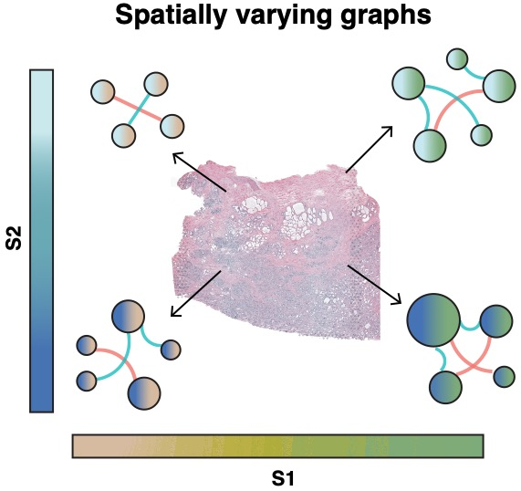
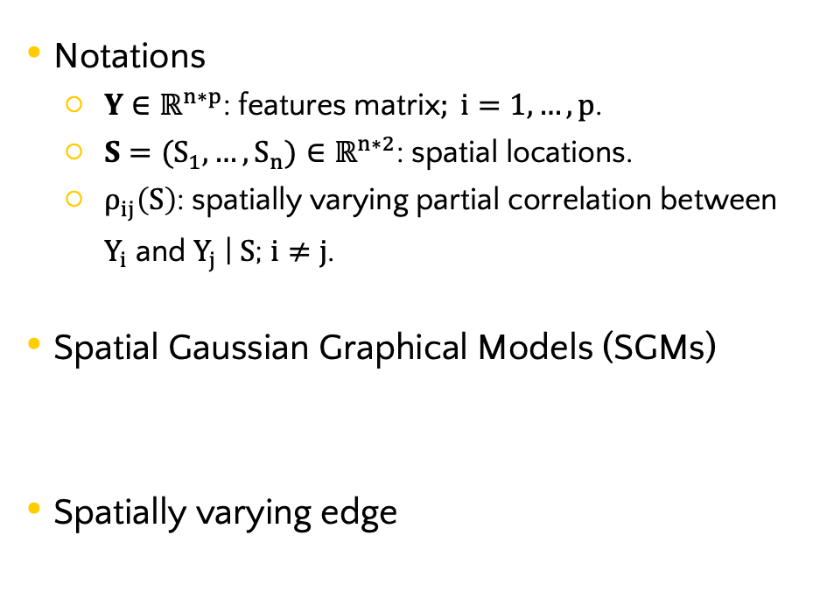

Spatially varying Gaussian Graphical Model
Notations
  $Y∈ℝ^{n∗p}$: features matrix$; i=1,…,p$.
  $S=(S_{1},…,S_{n})∈ℝ^{n∗2}$: spatial locations.
  $ρ_{ij}\left(S\right)$: spatially varying partial correlation between $Y_{i}$ and $Y_{j}$ | $S$; $i≠j$.
Spatial Gaussian Graphical Models (SGMs)
Spatially varying edge
Data structure
Spatially varying graphs
$Y(S)\sim N\left(μ(S),{Ω(S)}^{−1}\right)$
$E\left(S\right)=\left\{\left(i,j\right),i≠j s.t. ω_{ij}\left(S\right)≠0\right\}, for any S∈S$

Slide 12
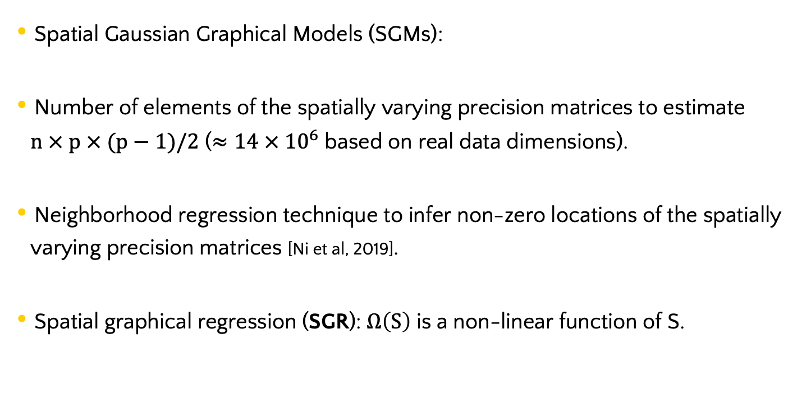

Spatial Graphical Regression
Spatial Gaussian Graphical Models (SGMs):
Number of elements of the spatially varying precision matrices to estimate $n × p × (p−1)/2$ ($≈14 × {10}^{6}$ based on real data dimensions).
Neighborhood regression technique to infer non-zero locations of the spatially varying precision matrices [Ni et al, 2019].
Spatial graphical regression (SGR): $Ω\left(S\right)$ is a non-linear function of S.
$Y(S)\sim N\left(μ(S),{Ω(S)}^{−1}\right)$

Slide 13
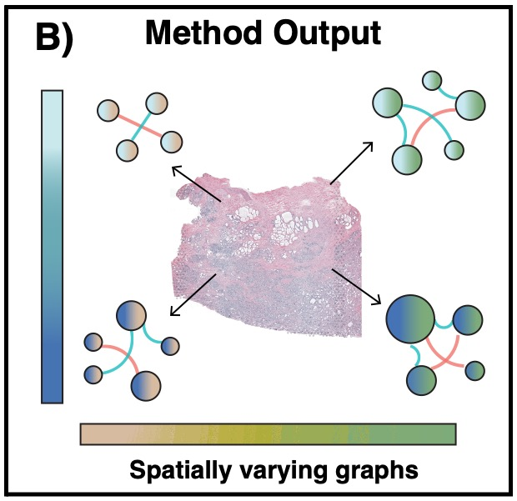
Spatial Graphical Models Overview

Slide 14
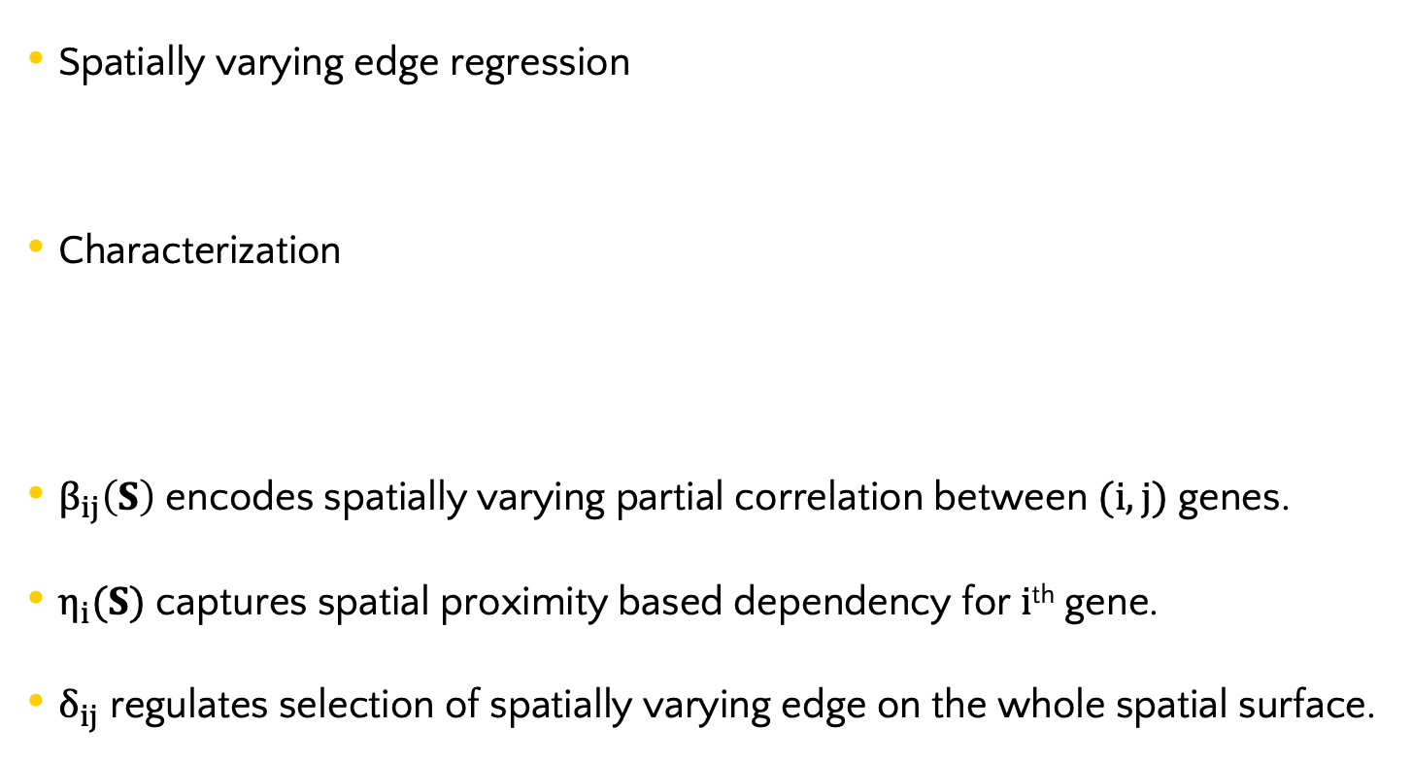
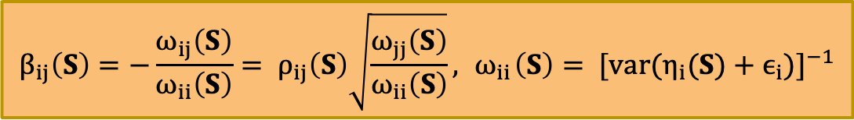
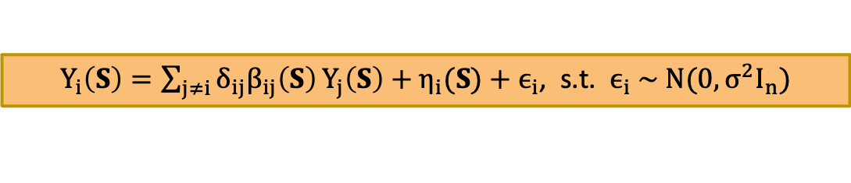
Spatial Graphical Regression
Spatially varying edge regression
Characterization
$β_{ij}\left(S\right)$ encodes spatially varying partial correlation between $(i,j)$ genes.
$η_{i}(S)$ captures spatial proximity based dependency for $i$^{th} gene.
$δ_{ij}$ regulates selection of spatially varying edge on the whole spatial surface.
$Y_{i}\left(S\right)=\sum_{j≠i}{δ_{ij}β_{ij}\left(S\right)}Y_{j}\left(S\right)+η_{i}(S)+ϵ_{i}$, s.t. $ϵ_{i} \sim N(0,σ^{2}I_{n})$
$$β_{ij}\left(S\right)=−\frac{ω_{ij}\left(S\right)}{ω_{ii}\left(S\right)}= ρ_{ij}\left(S\right)\sqrt{\frac{ω_{jj}\left(S\right)}{ω_{ii}\left(S\right)}}, { ω}_{ii}\left(S\right)= {[var(η_{i}(S)+ϵ_{i})]}^{−1}$$

Slide 15

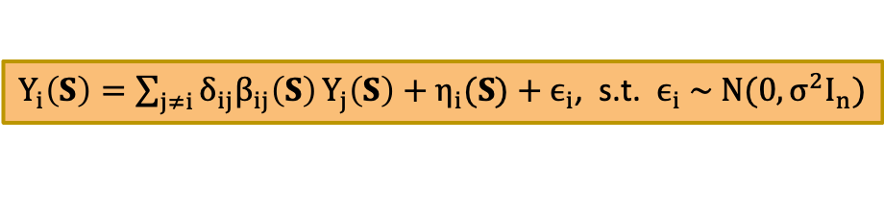
SGR Priors
Spatially varying edge regression
Flexible structure with Gaussian process priors.
Modified squared exponential kernel
$Y_{i}\left(S\right)=\sum_{j≠i}{δ_{ij}β_{ij}\left(S\right)}Y_{j}\left(S\right)+η_{i}(S)+ϵ_{i}$, s.t. $ϵ_{i} \sim N(0,σ^{2}I_{n})$
$$β_{ij}\left(S\right)\sim GP\left(0, τ_{ij}^{2}Κ_{s}^{β}\right), η_{i}(S)\sim GP\left(0, ζ_{i}^{2}Κ_{s}^{η}\right)$$
$K_{s} \left(S,S^{′}\right)=exp\{−a\left(|\left|S\right||_{2}^{2}−{||S}^{′}||_{2}^{2}\right)−b ||S−S^{′}||_{2}^{2}\}$ s.t. $a>0, b>0$

Slide 16
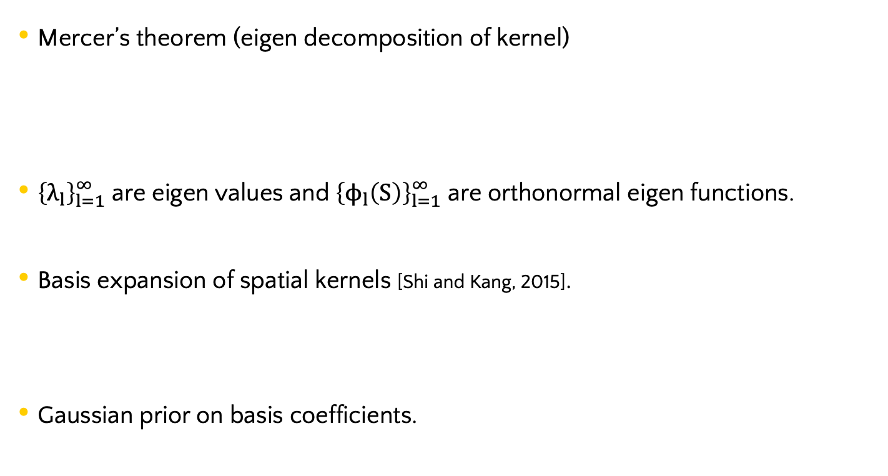

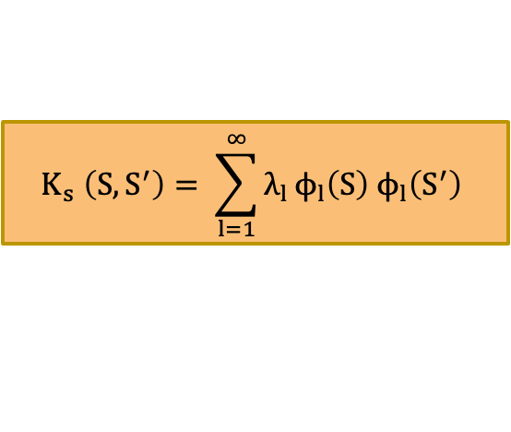
Kernel decomposition
Mercer’s theorem (eigen decomposition of kernel)
${\left\{λ_{l}\right\}}_{l=1}^{∞}$ are eigen values and ${\left\{ϕ_{l}\left(S\right)\right\}}_{l=1}^{∞}$ are orthonormal eigen functions.
Basis expansion of spatial kernels [Shi and Kang, 2015].
Gaussian prior on basis coefficients.
$$K_{s} \left(S,S^{′}\right)= \sum_{l=1}^{∞}{λ_{l}}ϕ_{l}\left(S\right) ϕ_{l}\left(S^{′}\right)$$
$$β_{ij}\left(S\right)={Φ^{β}(S)U}_{ij}^{β}, η_{i}\left(S\right)={Φ^{η}(S)U}_{i}^{η}$$

Slide 17

Decoupling of estimation and selection
Decoupling of estimation $(β)$ and selection $(δ)$.
Selection prior on $δ$: $δ_{ij} \sim Ber(p_{ij})$.

Slide 18



Hierarchical Global and Local Inference
Hypothesis: $β_{ij}\left(S\right)≡0$ vs $β_{ij}\left(S\right)≢0$.
Global edge probability
Local edge probability
$$P_{G}=Pr\left\{ δ_{ij}=0 \right| β_{ij}\left(S\right)≡0, ∀ S∈S \}$$
$$P_{L}=Pr\left\{ δ_{ij}≠0 \right| β_{ij}\left(S\right)≢0, for some S∈S \}$$

Slide 19
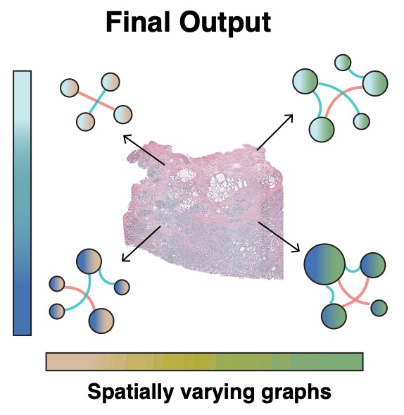
Hierarchical Global and Local Inference

Slide 20
Application of SGR on Breast Cancer Data
Breast Cancer Data [10x Genomics].
79 T-cell signature genes [Nirmal et al 2018] and ~5000 spatial locations.
Pathology based region annotation.

Slide 21
Spatially varying edges

Slide 22
Spatially varying networks for T-cell signature genes
Node sizes are proportional to number
of connected edges.
Sign:
Positive
Negative

Slide 23
Hub genes
Biologically relevant findings
BIN2 (score = 0.93) plays role in endocytosis [Sanchez-Barrena et al., 2012].
Upregulation of CD3D (score = 0.87) points to T-cell immune infiltration [Yang et al., 2020].

Slide 24
Hierarchical Spatial Graphical Regression

Slide 25
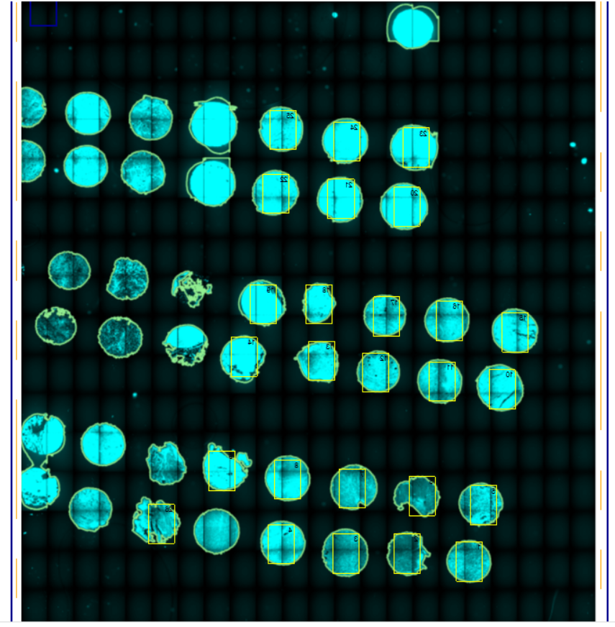
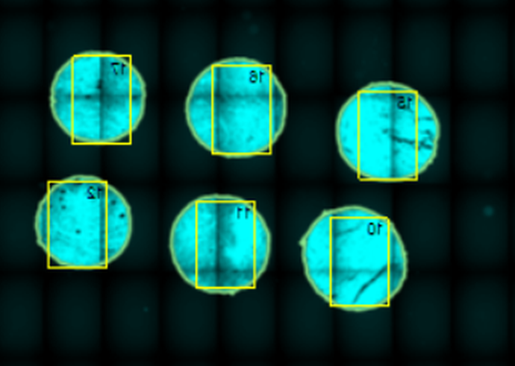
Motivating Data
CosMx Spatial Transcriptomics Dataset
  Obtained from a melanoma patient’s from MD Anderson Cancer Center.
  Genes on 24 fields of view (FOVs) are measured.
  The dataset contains 131,395 cells * 960 genes with spatial coordinates.
  Slide – Micro-environment (of tumor)
  FOV – Nano-environment (of tumor)
12
11
Slide Overview
19
20
17
16
FOV 18
15
FOV 23
FOV Magnification
12
11
FOV 17
10
FOV 25
FOV 22
Image Source: MD Anderson

Slide 26

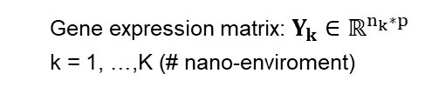
Data Structure
Single Sample: $Y∈ℝ^{n∗p}$
Multiple Regions
17
16
15
12
11
10
  Gene expression matrix: $Y_{k}∈ℝ^{n_{k}∗p}$
  k = 1, …,K (# nano-enviroment)

Slide 27
Heterogeneity and Commonalities
Heterogeneity: accommodate unique network structures within each distinct FOV.
Commonalities: Leverage shared insights across various FOVs.
17
16
15
12
11
10
Borrowing information based on spatial proximity.
Notes:
SHARE INFORMATION BASED ON SPATIAL PROXIMITY
Each nano-environment has distinct network structures
Closer ➔ similar network

Slide 28

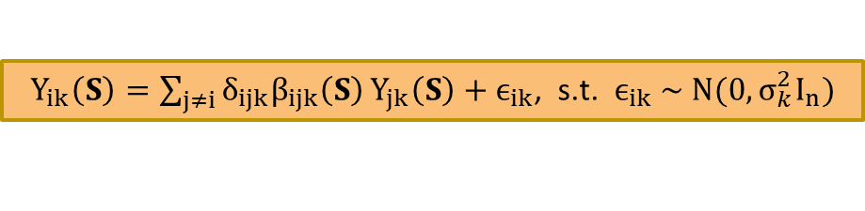
Hierarchical SGR Model
Spatially varying edge regression
Gaussian process priors to capture spatial information.
Spatial structure within nano-environment.
Modified squared exponential kernel
$Y_{ik}\left(S\right)=\sum_{j≠i}{δ_{ijk}β_{ijk}\left(S\right)}Y_{jk}\left(S\right)+ϵ_{ik}$, s.t. $ϵ_{ik} \sim N(0,σ_{k}^{2}I_{n})$
$$β_{ijk}\left(S\right)\sim GP\left(0, τ_{ijk}^{2}Κ_{s}^{β}\right)$$
$K_{s} \left(S,S^{′}\right)=exp\{−a\left(|\left|S\right||_{2}^{2}−{||S}^{′}||_{2}^{2}\right)−b ||S−S^{′}||_{2}^{2}\}$ s.t. $a>0, b>0$
Notes:
$β_{ij}\left(S\right)$ encodes spatially varying partial correlation between $(i,j)$ genes.
$δ_{ij}$ regulates selection of spatially varying edge on the whole spatial surface.

Slide 29


Hierarchical SGR Model
Nano-environment-specific selection indicator $δ_{ijk}$:
  Not a function of $S$.
  $Pr\left(γ_{ijk}\left(S\right)=0\right)=Pr\left(δ_{ijk}=0\right) ∀S$.
  Information leverage through selection indicator
  $→Cor(δ_{ijk}$, $δ_{ijk′})≠0,$and $∝$ spatial proximity/degree of similarity of two regions.
Selection indicator: $δ_{ijk}\sim Ber\left(Φ\left(λ_{ijk}\right)\right)$
$$Λ_{i}=\left(\begin{matrix}λ_{i11} & ⋯ & λ_{i1K} \\ ⋮ & ⋱ & ⋮ \\ λ_{ip1} & ⋯ & λ_{ipK}\end{matrix}\right)∈R^{\left(p−1\right)∗K}\sim MN\left(M_{i}, U_{i}, V_{i}\right)$$
Cor($δ_{ijk}$, $δ_{ijk′}$) $∝$ Cor($λ_{ijk}$, $λ_{ijk′}$)

Slide 30

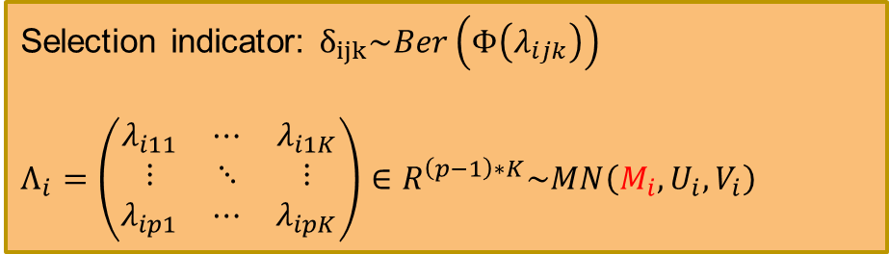
Hierarchical SGR Model
Nano-environment-specific selection indicator $δ_{ijk}$:
$M_{i}:$ Mean matrix – if $m_{ijk}<0$, then ${Pr(δ}_{ijk}=1)<0.5.$
Selection indicator: $δ_{ijk}\sim Ber\left(Φ\left(λ_{ijk}\right)\right)$
$$Λ_{i}=\left(\begin{matrix}λ_{i11} & ⋯ & λ_{i1K} \\ ⋮ & ⋱ & ⋮ \\ λ_{ip1} & ⋯ & λ_{ipK}\end{matrix}\right)∈R^{\left(p−1\right)∗K}\sim MN\left(M_{i}, U_{i}, V_{i}\right)$$

Slide 31

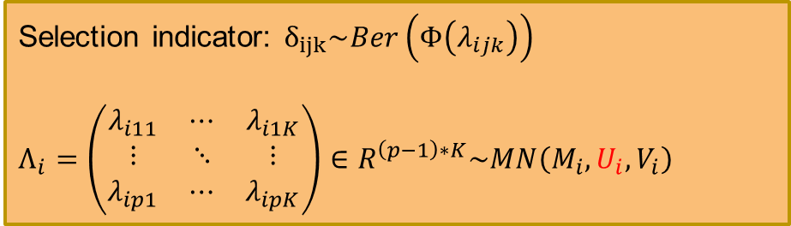
Hierarchical SGR Model
Nano-environment-specific selection indicator $δ_{ijk}$:
$M_{i}:$ Mean matrix – if $m_{ijk}<0$, then ${Pr(δ}_{ijk}=1)<0.5.$
$U_{i}:$ Column-wise correlation – Prior knowledge on gene correlation.
Selection indicator: $δ_{ijk}\sim Ber\left(Φ\left(λ_{ijk}\right)\right)$
$$Λ_{i}=\left(\begin{matrix}λ_{i11} & ⋯ & λ_{i1K} \\ ⋮ & ⋱ & ⋮ \\ λ_{ip1} & ⋯ & λ_{ipK}\end{matrix}\right)∈R^{\left(p−1\right)∗K}\sim MN\left(M_{i}, U_{i}, V_{i}\right)$$

Slide 32
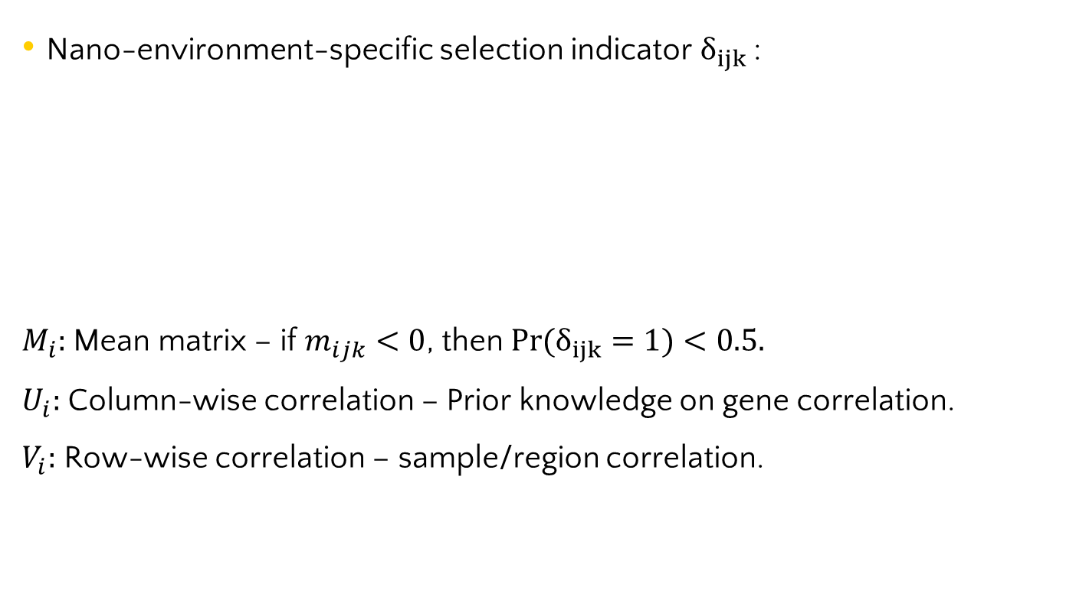

Hierarchical SGR Model
Nano-environment-specific selection indicator $δ_{ijk}$:
$M_{i}:$ Mean matrix – if $m_{ijk}<0$, then ${Pr(δ}_{ijk}=1)<0.5.$
$U_{i}:$ Column-wise correlation – Prior knowledge on gene correlation.
$V_{i}:$ Row-wise correlation – sample/region correlation.
Selection indicator: $δ_{ijk}\sim Ber\left(Φ\left(λ_{ijk}\right)\right)$
$$Λ_{i}=\left(\begin{matrix}λ_{i11} & ⋯ & λ_{i1K} \\ ⋮ & ⋱ & ⋮ \\ λ_{ip1} & ⋯ & λ_{ipK}\end{matrix}\right)∈R^{\left(p−1\right)∗K}\sim MN\left(M_{i}, U_{i}, V_{i}\right)$$

Slide 33
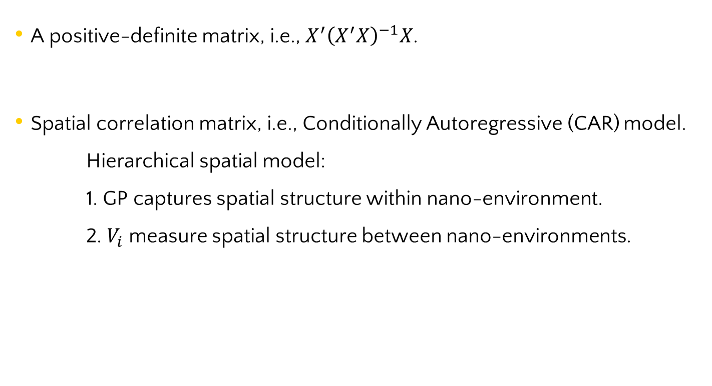
Selection of $V_{i}$
A positive-definite matrix, i.e., $X^{′}{\left(X^{′}X\right)}^{−1}X$.
Spatial correlation matrix, i.e., Conditionally Autoregressive (CAR) model.
    Hierarchical spatial model:
    1. GP captures spatial structure within nano-environment.
    2. $V_{i}$ measure spatial structure between nano-environments.

Slide 34

Selection of $V_{i}$
Recall CAR model:
  $Y_{i}|Y_{j} \sim N\left(\frac{ρ\sum_{j}{b_{ij}Y_{j}}}{\sum_{j}{b_{ij}}}, \frac{σ^{2}}{\sum_{j}{b_{ij}}}\right) →Y\sim N\left(0, σ^{−2}{\left(D−ρB\right)}^{−1}\right).$
  $B$: the neighborhood matrix, adjacency based, or distance weighted.
  $D=diag\{{\sum_{j}{b_{ij}\}}}_{i}$
In our case:
  Assume: $Λ_{ij} \sim N(0,σ_{Λi}^{−2}{\left(D−ρB\right)}^{−1})$
  B: weighted by distance between FOVs.
  Fixed $ρ.$
  Estimate $σ_{i}^{2}$.

Slide 35
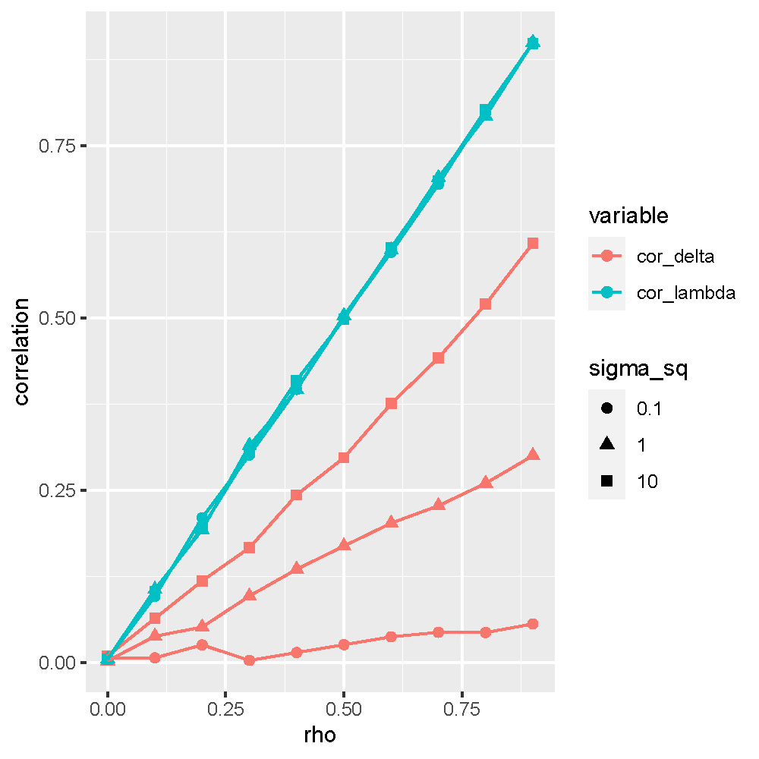

Selection of $V_{i}$
Effect of $V_{i}$ on $δ_{ij}∈R^{K}$
  Consider K = 2, e.g., 2 FOVs
  Set $U_{i}$ as identity matrix and $V_{i}=σ^{2}\left(\begin{matrix}1 & ρ \\ ρ & 1\end{matrix}\right)$, with $ρ=seq(0, 0.9, 0.1)$, $σ^{2}=0.1, 1, 10.$
  Draw $Λ_{ij} \sim N(0, V_{i})$, and $δ_{ij}\sim Ber(Φ(Λ_{ij}))$

Slide 36
Summary
Spatial Network Models
Study of spatially varying gene-gene coregulation
Detection of cancer driver genes
Potential targets for immunotherapy to
regulate gene/pathway functions

Slide 37
Summary
Spatial network models
  Allows heterogeneity and estimation of spatially varying networks across spatial domain in context of spatial transcriptomics.
  Extensive simulation study for calibration and comparison.
  Adaptation of different spatial kernels to incorporate several spatial patterns.
  Applications to cancer genomics datasets.

Slide 38
Thank you

Slide 39
SGR Simulation (Undirected setting)
Bottomline: better structural recovery for spatially varying graph setting

Slide 40
Application of SGR on Breast Cancer Data
Breast Cancer Data [10x Genomics].
B cell and T cell signature genes (33 and 79) [Nirmal et al 2018].
Pathology based region annotation.

Slide 41
Spatially varying edges

Slide 42
Spatially varying networks for B-cell signature genes
Node sizes are proportional to number
of connected edges.
Sign:
Positive
Negative

Slide 43
Hub genes
CD19 (score = 0.75) regulates B cell immune response [Wang et al., 2012].
FCRL2 (score = 0.75) influences tumor suppressing roles [Butti et al., 2018].
BIN2 (score = 0.93) plays role in endocytosis [Sanchez-Barrena et al., 2012].
Upregulation of CD3D (score = 0.87) points to T-cell immune infiltration [Yang et al., 2020].

