Slide 1
Bag of DAGs: Inferring Directional Dependence in Spatiotemporal Processes
Joint work with Michele Peruzzi and David Dunson
Bora Jin

Slide 2
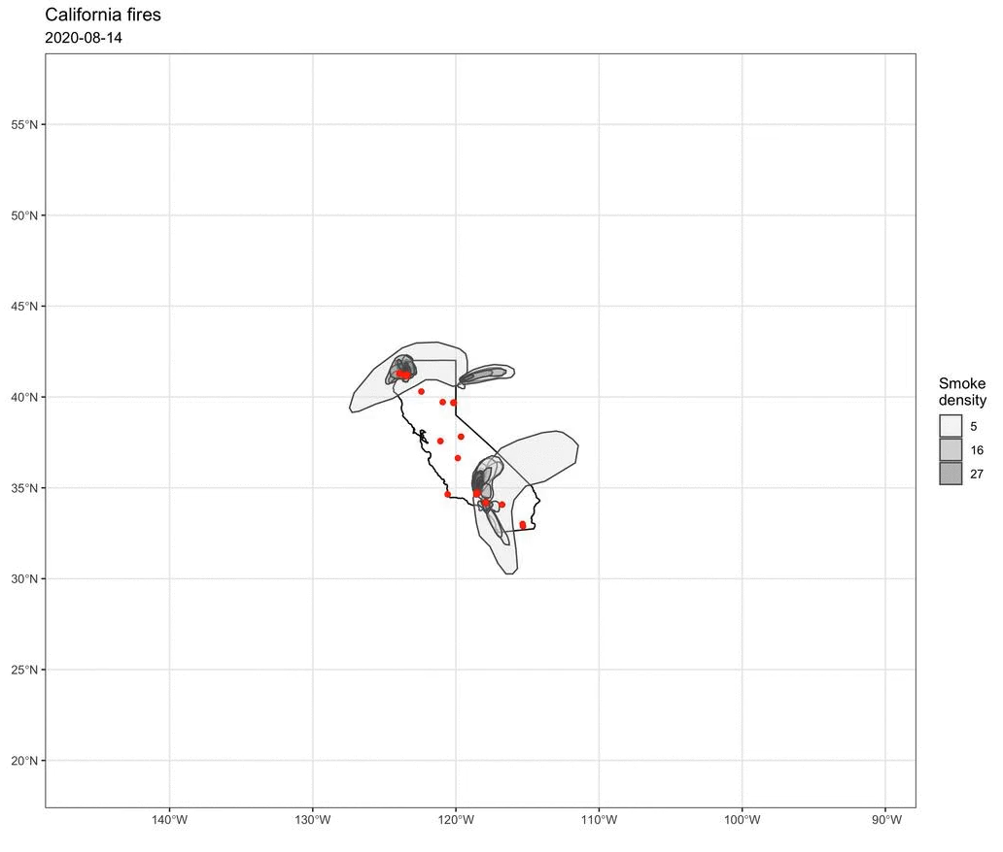
Motivation
Wildfire smoke spreads along wind directions.
Fine particulate matter (PM2.5) is the primary pollutants from wildfire emissions.
Want accurate spatiotemporal modeling for PM2.5 by capturing its directional dependence.

Slide 3
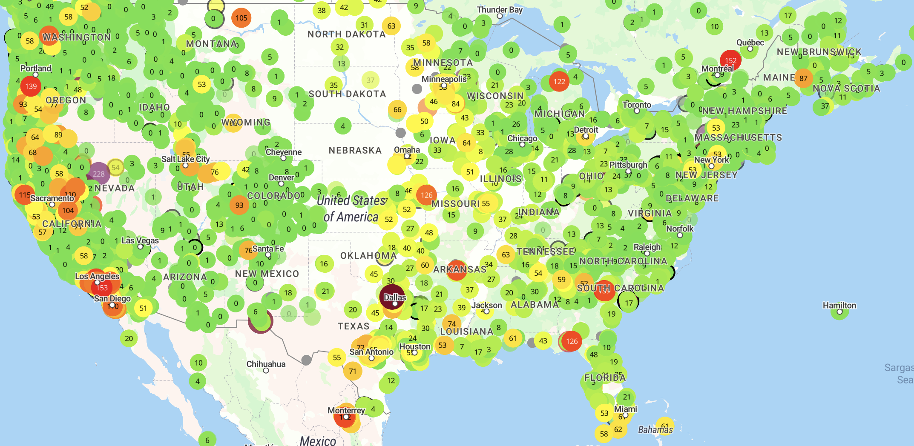
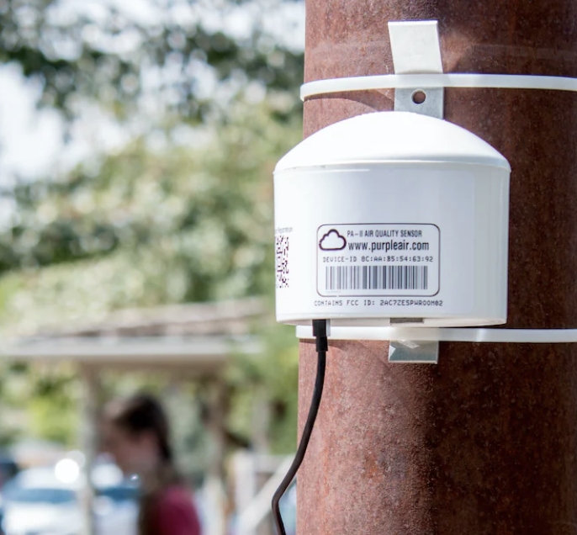
Characteristics of PM2.5 data
Large functional data
~18,000 low-cost sensors collect data at every 10 minutes in the US.
Use sparse Directed Acyclic Graph (DAG)-based processes for computational efficiency.

Slide 4
Characteristics of PM2.5 data
Varying directional correlations of PM2.5 in space and time
PM2.5 moves along wind directions.
Allow nonstationary correlations between two locations to peak if one is downwind of the other after a certain temporal lag.

Slide 5




Characteristics of PM2.5 data
Not always accompanied by wind direction data
Obtaining reliable wind direction data is troublesome especially at a sufficiently high spatial and temporal resolution.
Ambiguity in summarizing wind direction at discrete times; Average wind direction? Fastest wind?
Uncertainty about the true directional dependence in PM2.5.
Place a prior over directional edges within sparse DAGs for
interpretation and uncertainty quantification.
$$π_{1}$$
$$π_{2}$$
$$π_{3}$$
$$π_{4}$$

Slide 6
Existing nonstationary methods
Methods | Reference | 😀 | 😭
Deformation, Convolutions of kernels, Basis functions | Sampson (2010) | Basis of many other extensions | Difficulties in computation, interpretation, practical effects of uncertainty quantification
Nonstationarity-informing covariates in covariance functions | Calder (2008), Neto et al. (2014) | Improved interpretability | Nonstationarity-informing data not always available
Sparse (Cholesky decomposition of a) precision matrix | Krock et al. (2021), Kidd and Katzfuss (2022) | Computational efficiency | No uncertainty quantification, not a valid process
Spatial dependence in atoms or mixing weights in mixture | Gelfand et al. (2005), Fuentes and Reich (2013) | Flexibility, Non-Gaussian data | Unable to characterize directional dependence

Slide 7
Objectives
Aim to construct a class of nonstationary processes that
  Are valid and scalable.
  Yield interpretable directional dependence that varies in space and time.
  Enable uncertainty quantification.
  Does not require nonstationarity-informing covariates.
Use a sparse DAG.
  Node:
  Directed edge:
  Achieve computational efficiency through well-structured sparsity.
spatial regions
directional dependence among spatial regions

Slide 8
Objectives
Why not using existing methods based on sparse DAGs?
  Inappropriate or unrealistic fixed DAGs

Slide 9
Objectives
Why not using existing methods based on sparse DAGs?
  Inappropriate or unrealistic fixed DAGs
  When data are generated with certain directions, including locations from wrong directions will increase Kullback-Leibler divergence of the resulting density to the true data generating density.
  We use DAGs primarily to infer interpretable dependence structures, not just as a tool for computational scalability.

Slide 10

Objectives
Overcome inflexibility in fixed DAG approaches.
Infer a sparse DAG.
  Directed edges $≈$ winds → Interpretable nonstationarity
  Let the directed edges unknown. → Uncertainty quantification
  Characterize flexible directional dependence in space and time.

Slide 11

Construction
Domain $𝒟= 𝒮 ⊔ 𝒰$, reference locations $𝒮$ and other locations $𝒰$
Node: partition a domain into disjoint regions, $𝒟=\bigcup_{i=1}^{M}{𝒟_{i}},𝒟_{i}∩𝒟_{j}=∅.$

Slide 12




Construction
Directed edge: over $K$ possible edges, choose the one that explains variability of each partition block the most, $Z=(z_{1},…,z_{M})$.
$$z_{i}=2$$
2
1
3
1
$$z_{i}=1$$
1
2
2
3
4
4
3
$$z_{i}=4$$

Slide 13

Construction
Directed edge: over $K$ possible edges, choose the one that explains variability of each partition block the most, $Z=(z_{1},…,z_{M})$.
2
3
1
4
1
2
4
8
5
3
7
6

Slide 14
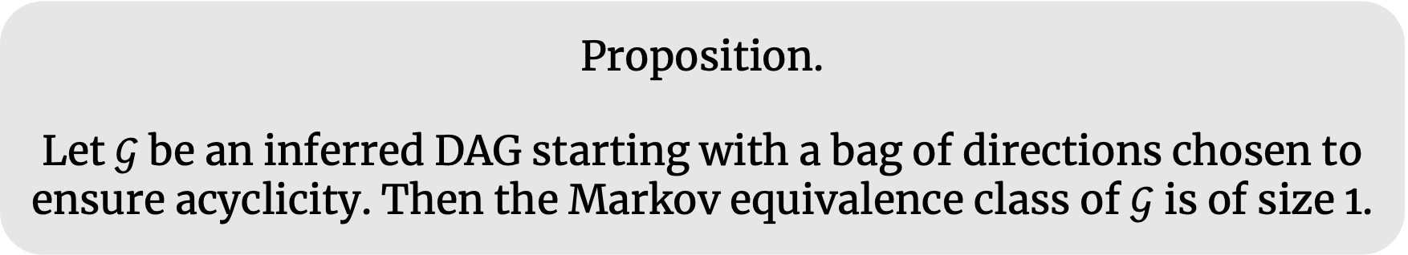
Construction
A subset of directions considered in a bag to ensure acyclicity of inferred directed graphs.
The inferred DAG in our framework is identifiable.
Proposition.
Let $𝒢$ be an inferred DAG starting with a bag of directions chosen to ensure acyclicity. Then the Markov equivalence class of $𝒢$ is of size 1.

Slide 15
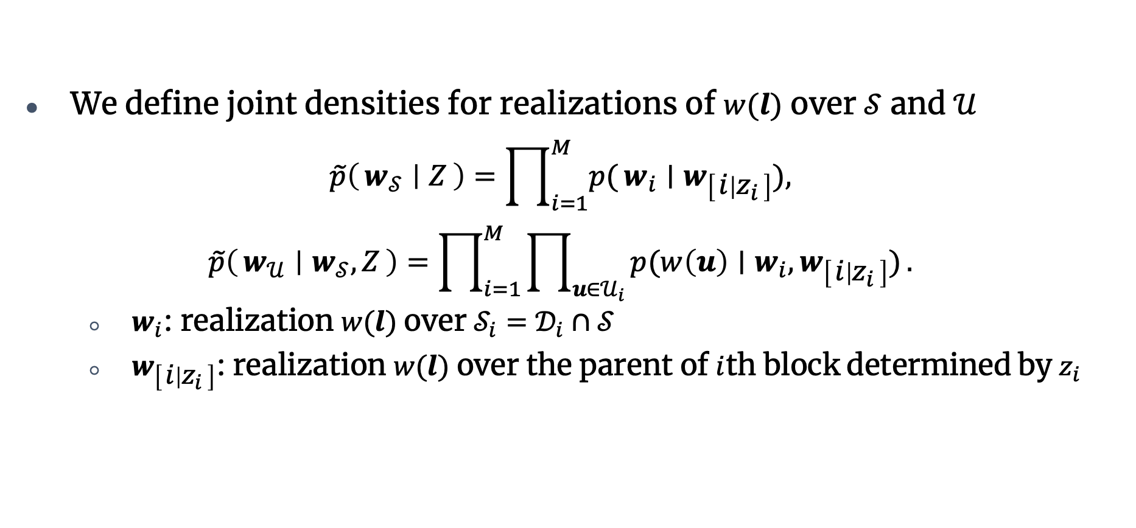
Bag of directed Acyclic Graphs (BAGs)
We define joint densities for realizations of $w(l)$ over $𝒮$ and $𝒰$
$$\tilde{p}\left(w_{𝒮} ∣ Z\right)=\prod_{i=1}^{M}{p(}w_{i}∣w_{\left[i ∣ z_{i}\right]}),$$
$$\tilde{p}\left(w_{𝒰} ∣ w_{𝒮}, Z\right)=\prod_{i=1}^{M}{\prod_{u∈𝒰_{i}}{p(w\left(u\right)∣w_{i},w_{\left[i ∣ z_{i}\right]})}}.$$
  $w_{i}$: realization $w(l)$ over $𝒮_{i}=𝒟_{i}∩𝒮$
  $w_{\left[i ∣ z_{i}\right]}$: realization $w(l)$ over the parent of $i$th block determined by $z_{i}$

Slide 16
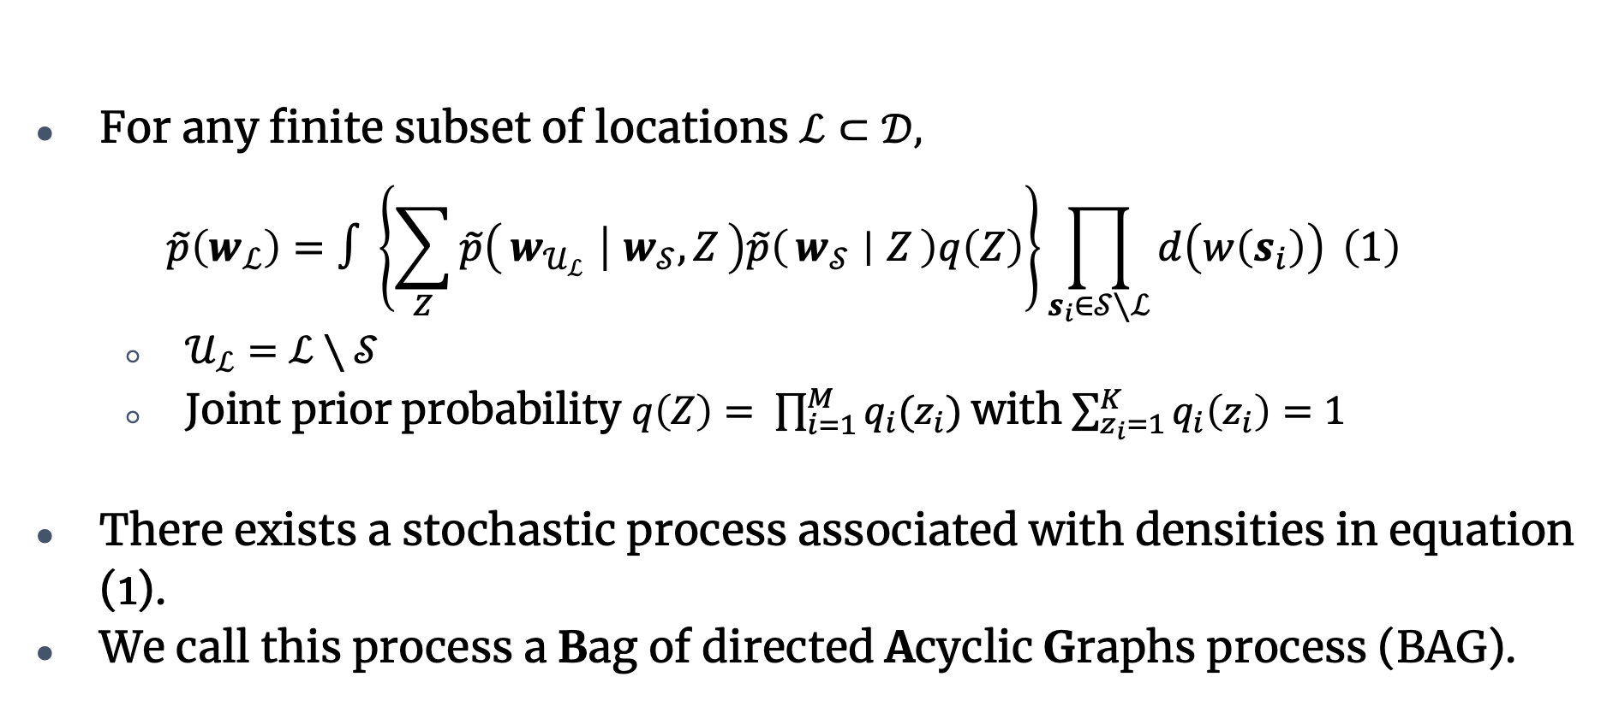
BAGs
For any finite subset of locations $ℒ⊂𝒟,$
$$\begin{aligned}\tilde{p}\left(w_{ℒ}\right)=∫\left\{\sum_{Z}{\tilde{p}\left(w_{𝒰_{ℒ}} ∣ w_{𝒮}, Z\right)\tilde{p}\left(w_{𝒮} ∣ Z\right)q\left(Z\right)}\right\}\prod_{s_{i}∈𝒮∖ℒ}{d\left(w\left(s_{i}\right)\right)} \#\left(1\right) \end{aligned}$$
  $𝒰_{ℒ}=ℒ∖𝒮$
  Joint prior probability $q\left(Z\right)= \prod_{i=1}^{M}{q_{i}(z_{i})}$with $\sum_{z_{i}=1}^{K}{q_{i}\left(z_{i}\right)}=1$
There exists a stochastic process associated with densities in equation (1).
We call this process a Bag of directed Acyclic Graphs process (BAG).

Slide 17
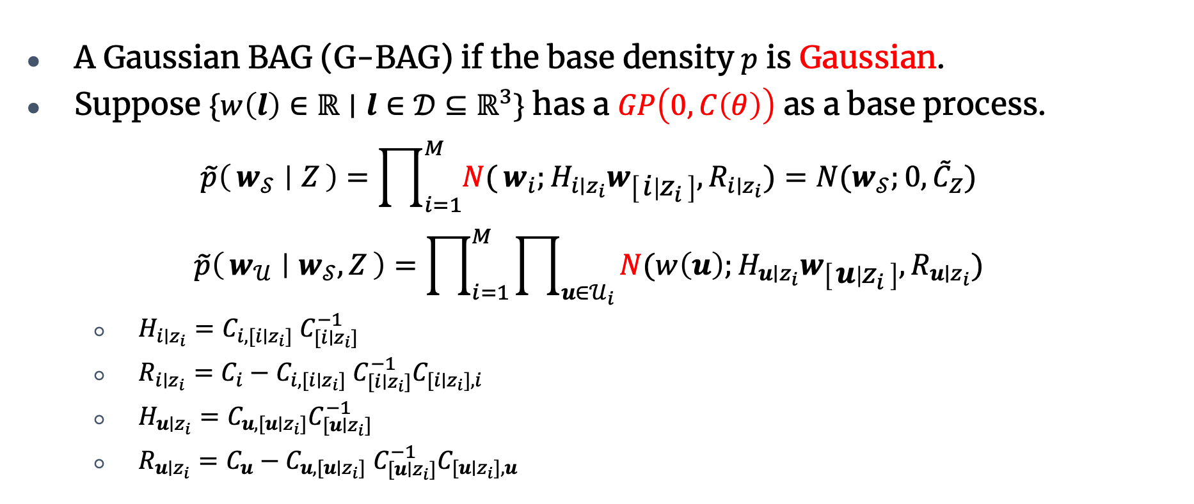
Gaussian BAGs (G-BAGs)
A Gaussian BAG (G-BAG) if the base density $p$ is Gaussian.
Suppose $\{w\left(l\right)∈ℝ∣l∈𝒟⊆ℝ^{3}\}$ has a $GP\left(0,C\left(θ\right)\right)$ as a base process.
$$\tilde{p}\left(w_{𝒮} ∣ Z\right)=\prod_{i=1}^{M}{N(}w_{i};H_{i∣z_{i}}w_{\left[i ∣ z_{i}\right]},R_{i∣z_{i}})=N(w_{𝒮};0,{\tilde{C}}_{Z})$$
$$\tilde{p}\left(w_{𝒰} ∣ w_{𝒮}, Z\right)=\prod_{i=1}^{M}{\prod_{u∈𝒰_{i}}{N(w\left(u\right);H_{u∣z_{i}}w_{\left[u ∣ z_{i}\right]},R_{u∣z_{i}})}}$$
  $H_{i∣z_{i}}=C_{i,[i∣z_{i}]} C_{[i∣z_{i}]}^{−1}$
  $R_{i∣z_{i}}=C_{i}−C_{i,[i∣z_{i}]} C_{[i∣z_{i}]}^{−1}C_{[i∣z_{i}],i}$
  $H_{u∣z_{i}}=C_{u,[u∣z_{i}]}C_{[u∣z_{i}]}^{−1}$
  $R_{u∣z_{i}}=C_{u}−C_{u,[u∣z_{i}]} C_{[u∣z_{i}]}^{−1}C_{[u∣z_{i}],u}$

Slide 18
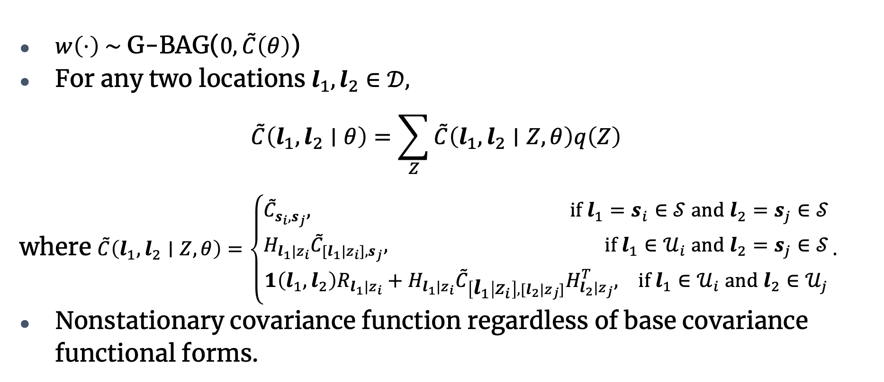
G-BAGs
$w\left(⋅\right) \sim$G-BAG($0,\tilde{C}\left(θ\right)$)
For any two locations $l_{1}, l_{2}∈𝒟,$
$$\tilde{C}\left(l_{1}, l_{2}∣θ\right)=\sum_{Z}{\tilde{C}\left(l_{1}, l_{2}∣Z,θ\right)q\left(Z\right)}$$
where $\tilde{C}\left(l_{1}, l_{2}∣Z,θ\right)=\left\{\begin{aligned}{\tilde{C}}_{s_{i}, s_{j}}, if l_{1}=s_{i}∈𝒮 and l_{2}=s_{j}∈𝒮 \\ H_{l_{1}|z_{i}}{\tilde{C}}_{[l_{1}|z_{i}], s_{j}}, if l_{1}∈𝒰_{i} and l_{2}=s_{j}∈𝒮 \\ 1\left(l_{1},l_{2}\right)R_{l_{1}|z_{i}}+H_{l_{1}|z_{i}}{\tilde{C}}_{\left[l_{1} | z_{i}\right], [l_{2}|z_{j}]}H_{l_{2}|z_{j}}^{T}, if l_{1}∈𝒰_{i} and l_{2}∈𝒰_{j}\end{aligned}\right..$
Nonstationary covariance function regardless of base covariance functional forms.

Slide 19
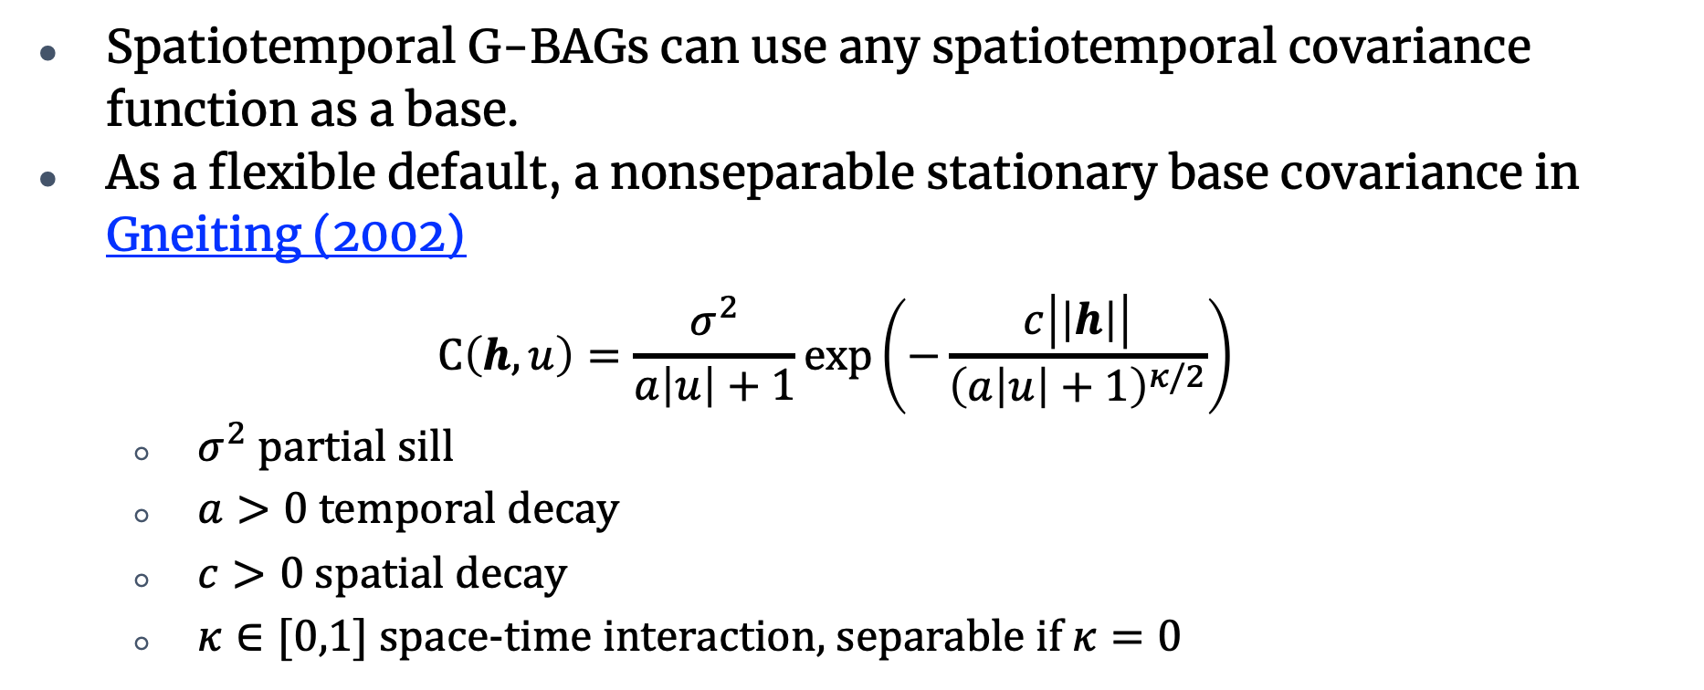
G-BAGs
Spatiotemporal G-BAGs can use any spatiotemporal covariance function as a base.
As a flexible default, a nonseparable stationary base covariance in Gneiting (2002)
$$C\left(h,u\right)=\frac{σ^{2}}{a\left|u\right|+1}exp\left(−\frac{c\left|\left|h\right|\right|}{{\left(a\left|u\right|+1\right)}^{κ/2}}\right)$$
  $σ^{2}$partial sill
  $a>0$ temporal decay
  $c>0$ spatial decay
  $κ∈[0,1]$ space-time interaction, separable if $κ=0$

Slide 20

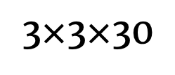
G-BAGs
G-BAGs induce directional nonstationarity in time even when implemented using stationary base covariance functions.
Stationary base covariance$C\left(h,u\right)=\frac{σ^{2}}{a\left|u\right|+1}exp\left(−\frac{c\left|\left|h\right|\right|}{{\left(a\left|u\right|+1\right)}^{κ/2}}\right)$
  $σ^{2}=1, a=2, c=0.8, κ=0$
  $𝒮=3×3×30$ grid on $𝒟={\left[0,1\right]}^{3}$, $M=3×3×30$
  $q\left(Z_{west}\right)=1$
Covariance of a point in black at $(0.5, 0.5, t^{∗})$to
  locations on its left
  locations on its right at different time points.
3$×$3$×$30

Slide 21
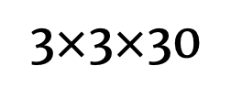
G-BAGs
3$×$3$×$30

Slide 22
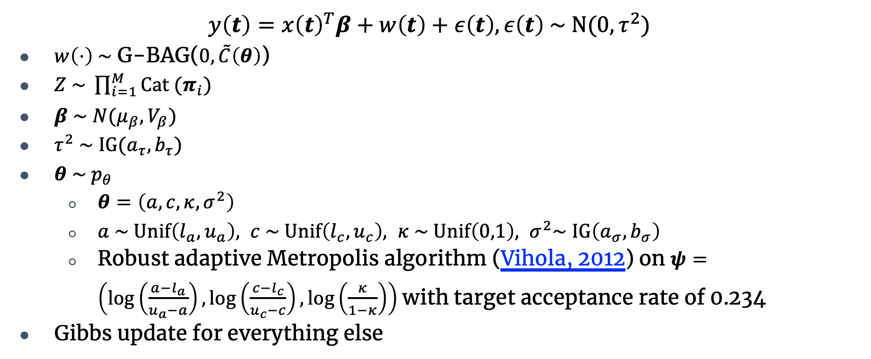
Bayesian hierarchical model with G-BAGs
$$y\left(t\right)=x{\left(t\right)}^{T}β+w\left(t\right)+ε\left(t\right), ε\left(t\right) \sim N(0, τ^{2})$$
$w\left(⋅\right) \sim \text{G}\text{−}\text{BAG}\text{(}0,\tilde{C}\left(θ\right)$)
$Z \sim \prod_{i=1}^{M}{Cat (π_{i})}$
$β \sim N(μ_{β},V_{β})$
$τ^{2} \sim IG(a_{τ},b_{τ})$
$θ \sim p_{θ}$
  $θ=\left(a,c,κ,σ^{2}\right)$
  $a \sim Unif\left(l_{a}, u_{a}\right), c \sim Unif\left(l_{c}, u_{c}\right), κ \sim Unif\left(0,1\right), σ^{2}\sim IG\left(a_{σ}, b_{σ}\right)$
  Robust adaptive Metropolis algorithm (Vihola, 2012) on $ψ=\left(\log\left(\frac{{a−l}_{a}}{u_{a}−a}\right),\log\left(\frac{{c−l}_{c}}{u_{c}−c}\right),\log\left(\frac{κ}{1−κ}\right)\right)$ with target acceptance rate of 0.234
Gibbs update for everything else

Slide 23
Simulation 1: Fitted G-BAG is correctly specified
G-BAG identifies directions.
1,000 samples after 10,000 burn-ins and 7 thinning
Averaged over 25 replicates

Slide 24
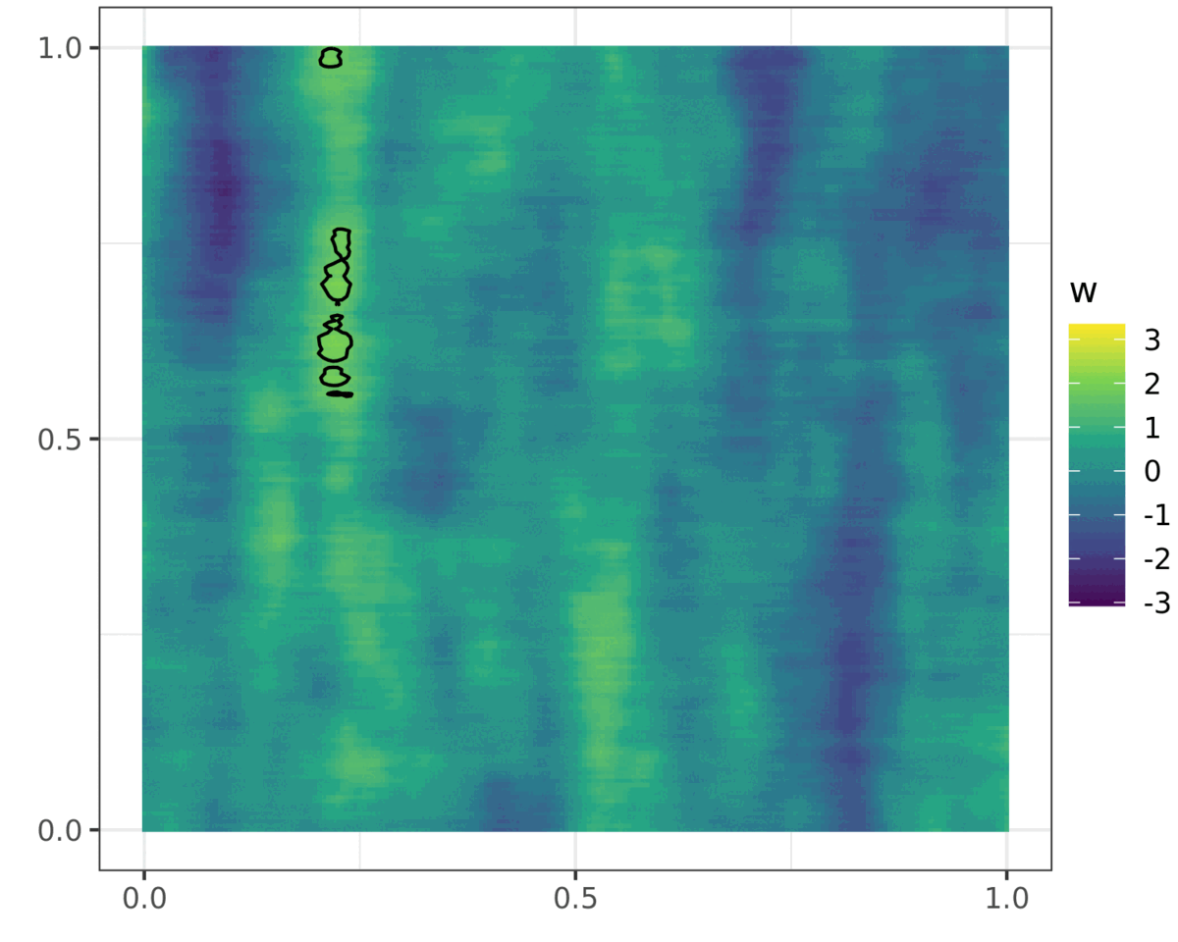
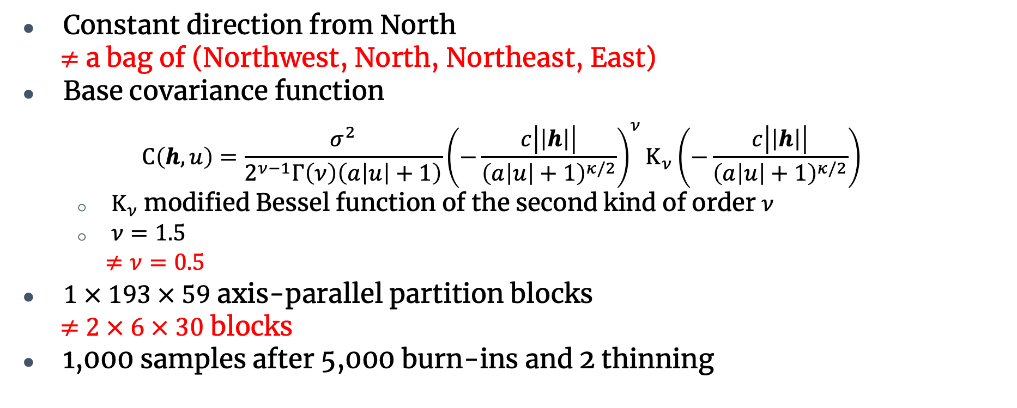
Simulation: Fitted G-BAG is misspecified
Constant direction from North
$≠$ a bag of (Northwest, North, Northeast, East)
Base covariance function
$$C\left(h,u\right)=\frac{σ^{2}}{2^{ν−1}Γ\left(ν\right)\left(a\left|u\right|+1\right)}{\left(−\frac{c\left|\left|h\right|\right|}{{\left(a\left|u\right|+1\right)}^{κ/2}}\right)}^{ν}K_{ν}\left(−\frac{c\left|\left|h\right|\right|}{{\left(a\left|u\right|+1\right)}^{κ/2}}\right)$$
  $K_{ν}$ modified Bessel function of the second kind of order $ν$
  $ν=1.5$
  $≠ν=0.5$
$1 × 193 × 59$ axis-parallel partition blocks
$≠$ $2 × 6 × 30$ blocks
1,000 samples after 5,000 burn-ins and 2 thinning

Slide 25
Simulation 2: Fitted G-BAG is misspecified
G-BAG can still find the true direction.
  Histogram of wind directions with the highest posterior probability in each partition block

Slide 26
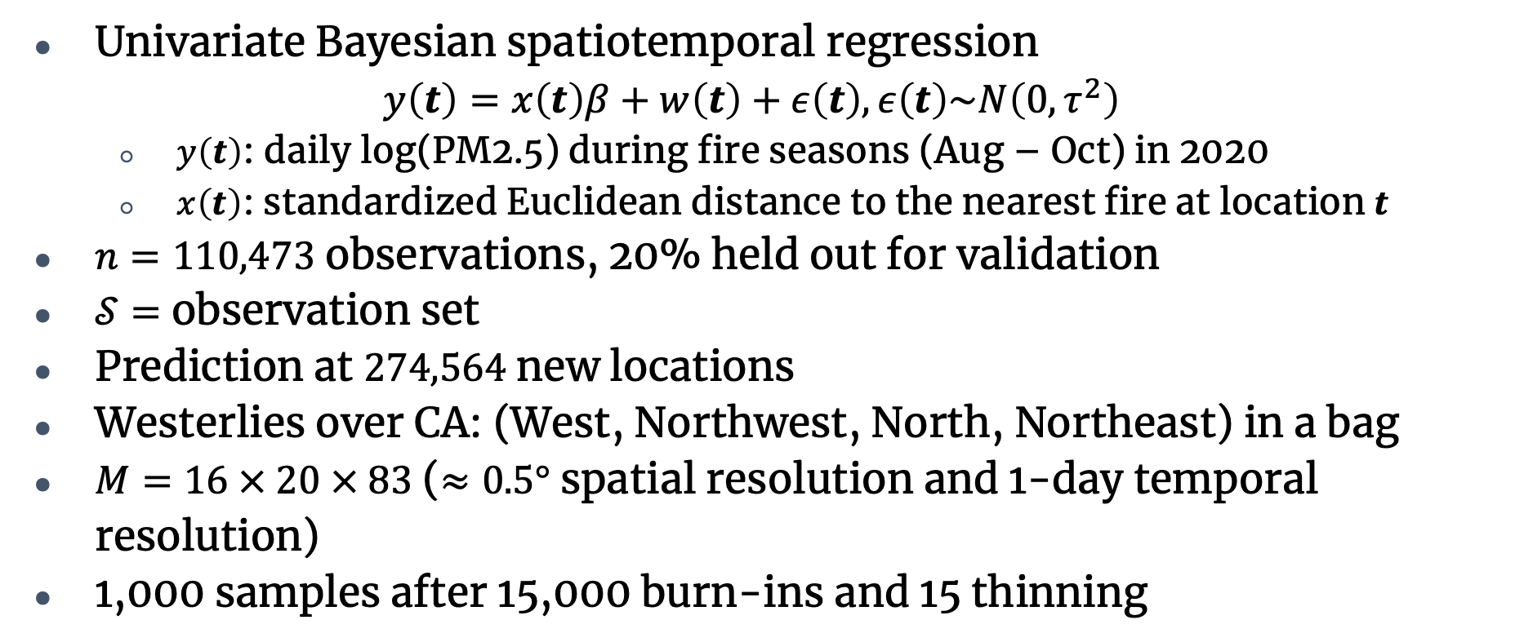
PM2.5 in California, the United States
Univariate Bayesian spatiotemporal regression
$$y\left(t\right)=x\left(t\right)β+w\left(t\right)+ε\left(t\right), ε\left(t\right)\sim N\left(0, τ^{2}\right)$$
  $y\left(t\right)$: daily log(PM2.5) during fire seasons (Aug – Oct) in 2020
  $x\left(t\right)$: standardized Euclidean distance to the nearest fire at location $t$
$n=110,473$ observations, 20% held out for validation
$𝒮=$ observation set
Prediction at $274,564$ new locations
Westerlies over CA: (West, Northwest, North, Northeast) in a bag
$M=16 × 20 × 83$ ($≈0.5°$ spatial resolution and 1-day temporal resolution)
1,000 samples after 15,000 burn-ins and 15 thinning

Slide 27
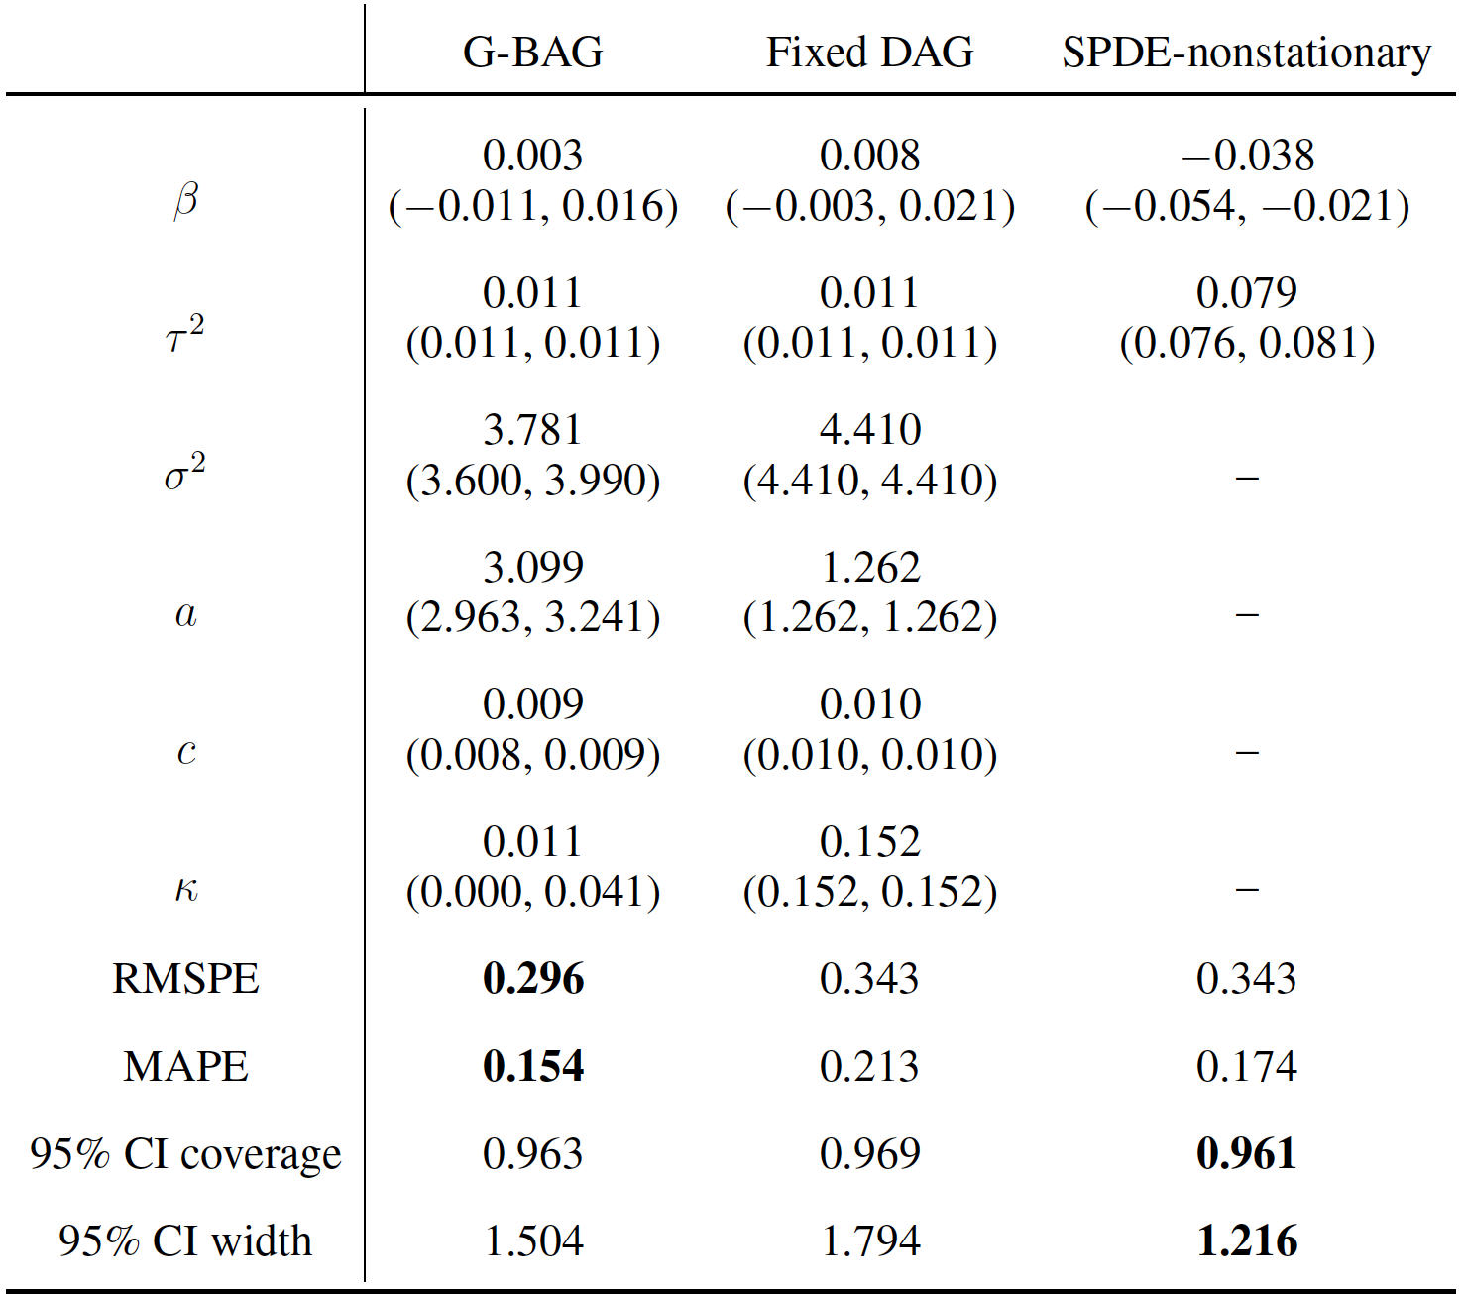
PM2.5 in California, the United States
👏
50%

Slide 28
PM2.5 in California, the United States
2020-08-16, ignition of August Complex
Annual standard by EPA
24-hour standard by EPA

Slide 29
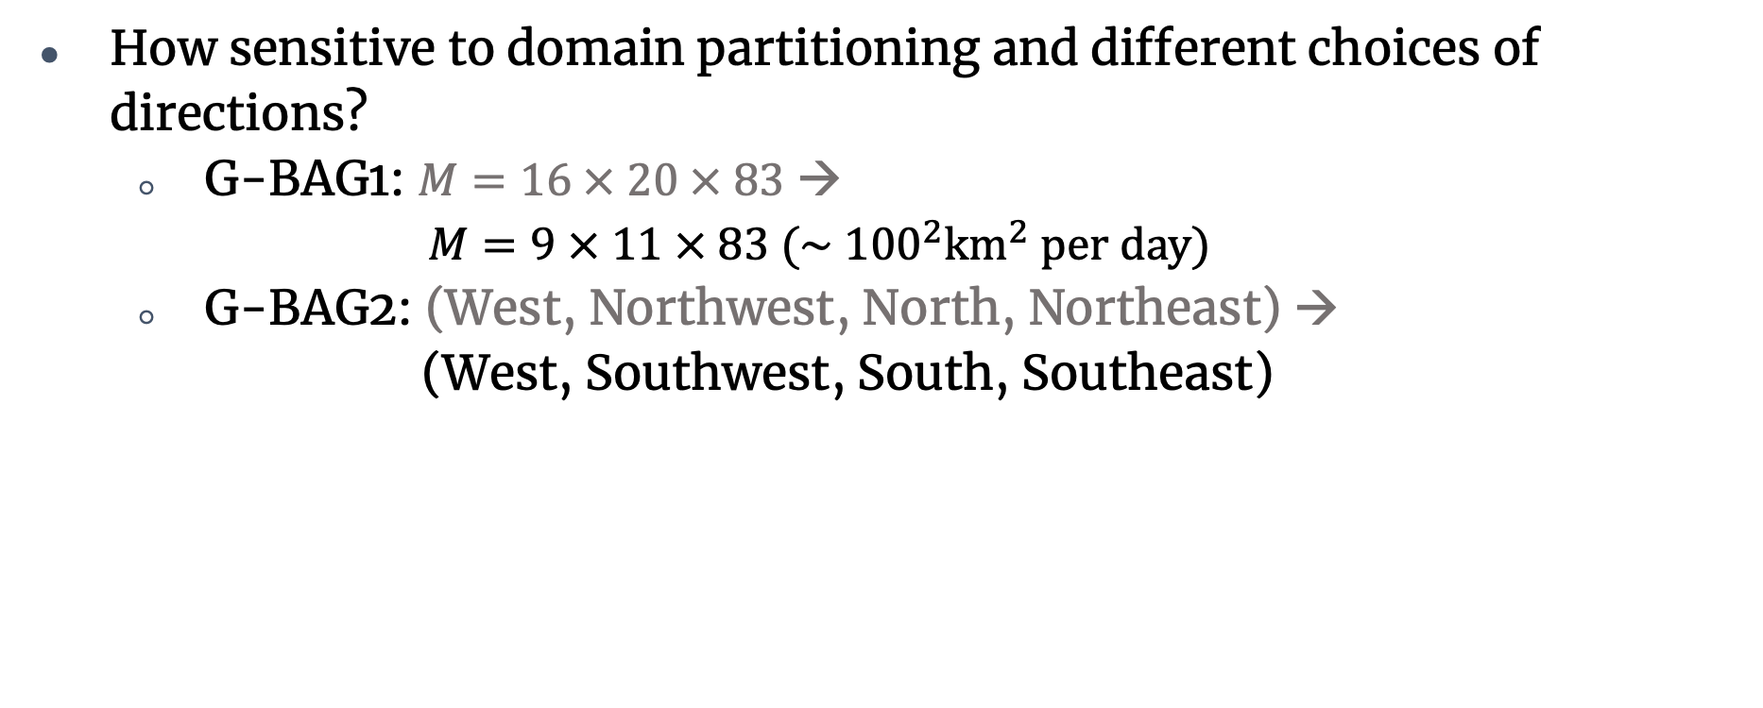
PM2.5 in California, the United States
How sensitive to domain partitioning and different choices of directions?
  G-BAG1: $M=16 × 20 × 83$ →
  $$M=9 × 11 × 83 (\sim {100}^{2}{km}^{2} per day)$$
  G-BAG2: (West, Northwest, North, Northeast) →
  (West, Southwest, South, Southeast)

Slide 30
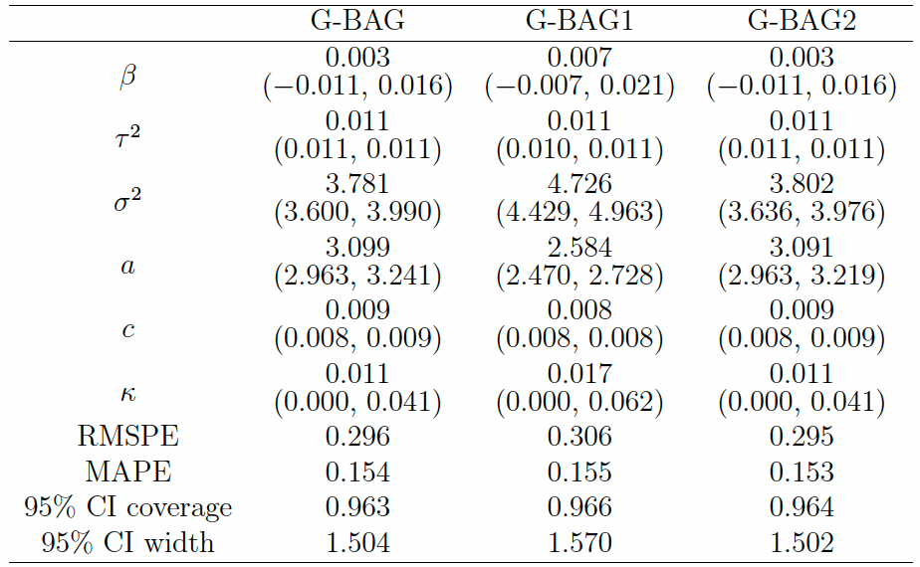
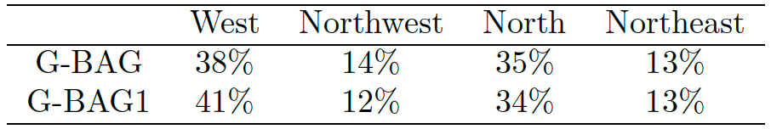
PM2.5 in California, the United States
Show robustness in terms of parameter estimation and predictions;
and % of partitioned regions that chose each direction as the most likely direction

Slide 31
Discussion
Proposed nonstationary processes by allowing unknown directed edges over a domain partition.
Directed edges represent varying directional dependence in space and time.
Achieved computational efficiency through sparse DAGs.
Induced directional nonstationarity in time even from stationary base covariance functions.
Possible extensions
  Reduce sensitivity to domain partitioning by including several different possibilities within a single ensemble analysis.
  Replace GPs with heavier-tailed processes that are more robust to outliers, e.g., t-BAGs with a Student’s t-process.
  Allow spatial dependence in directed edges of neighboring spatial regions.

Slide 32

Thanks for your attention!

